Slide 1

Problem solving techniques
L2

Slide 2
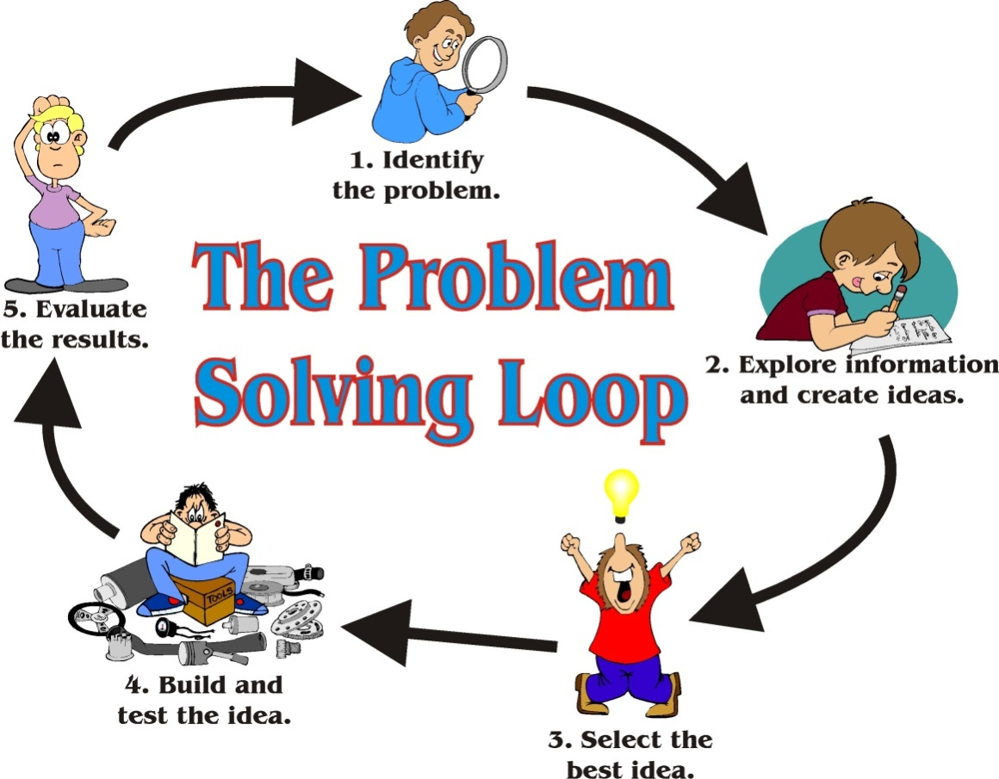
Introduction to problem solving, programming paradigms and methodologies.

Slide 3
Objectives
To learn and appreciate the following concepts
Problem solving basics
Logic and its importance in problem solving
Various computational problems and its classification
Introduction to programming paradigms and methodologies

Slide 4
Session outcome
At the end of session the student will be able to understand
fundamental requirement in problem solving
programming paradigms and methodologies

Slide 5
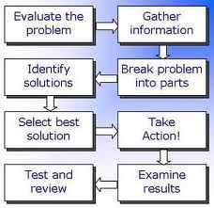
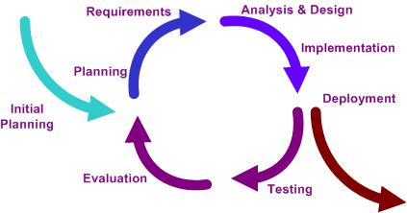
Introduction to problem solving
Notes:
Additional notes on problem solving
A problem exists when there is a situation you want to resolve but no solution is readily apparent. Problem solving is the process by which the unfamiliar situation is resolved. A situation that is a problem to one person may not be a problem to someone else.

Slide 6
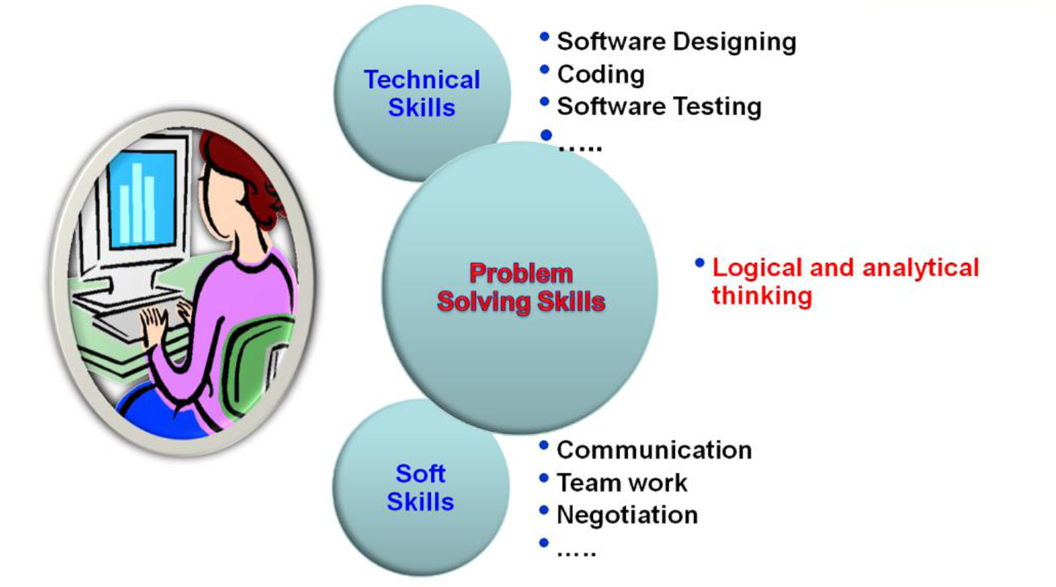
Skill set required for SW Engineers
Notes:
Additional notes on problem solving skills
Problem solving Skill is the key skill required for a software engineer as it helps to develop technical as well as soft skills.
Logical Thinking
Thinking in terms of cause and consequences
Sequential thinking
Means following a train of thought
Helps in decision making and problem solving

Slide 7
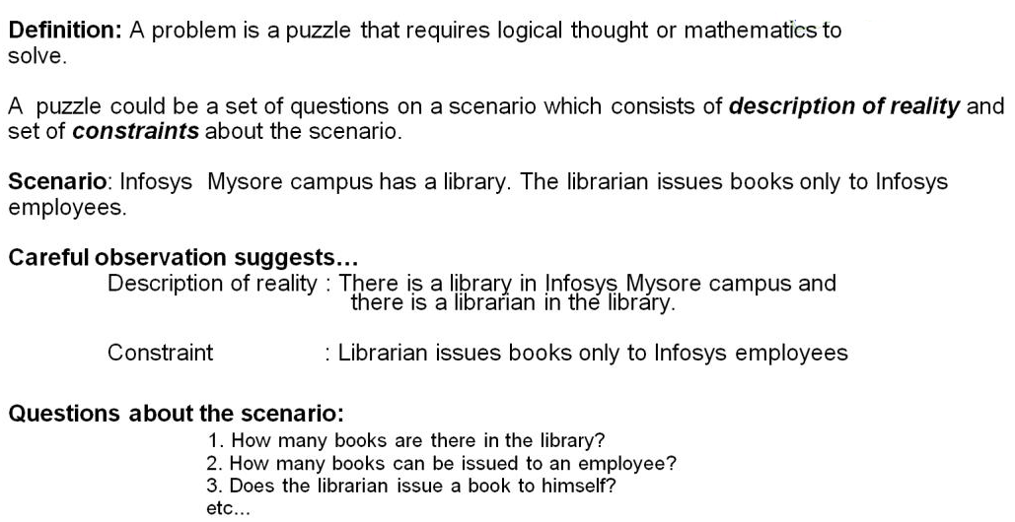
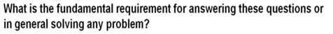
What is a problem?

Slide 8
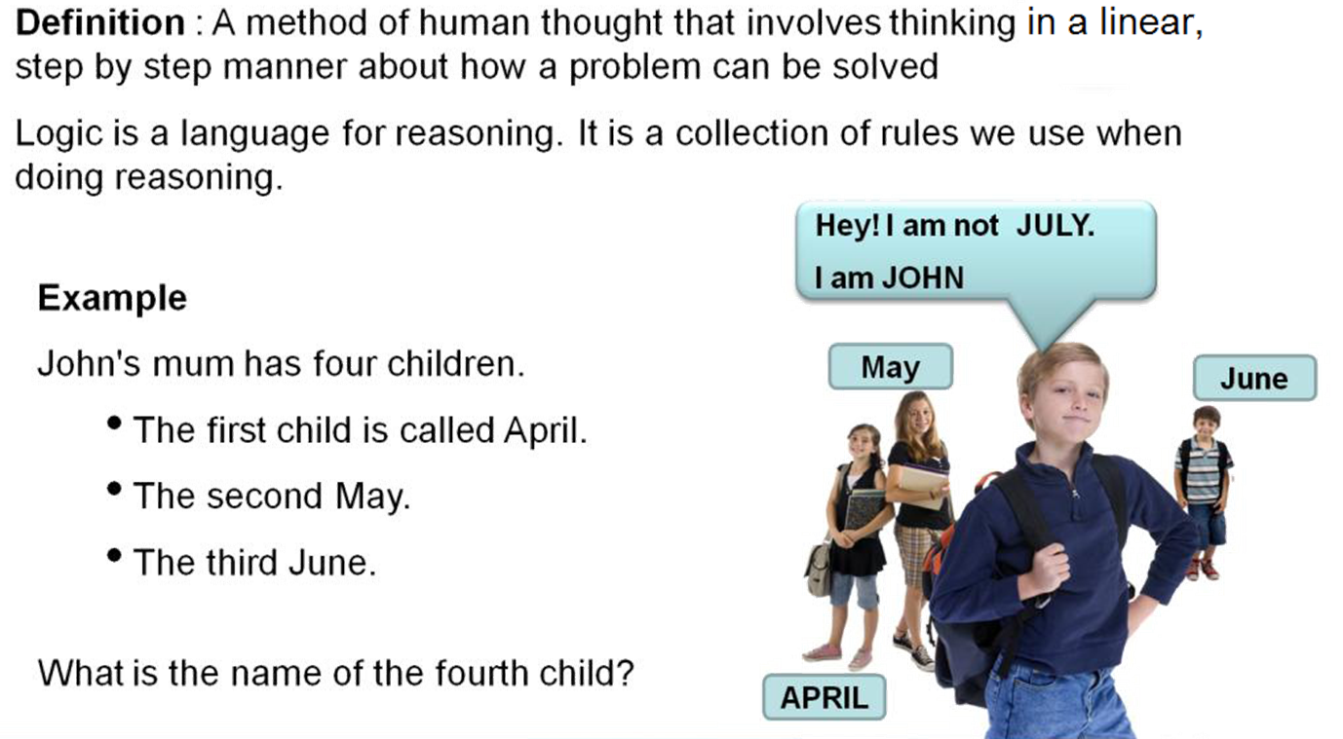
Logic

Slide 9
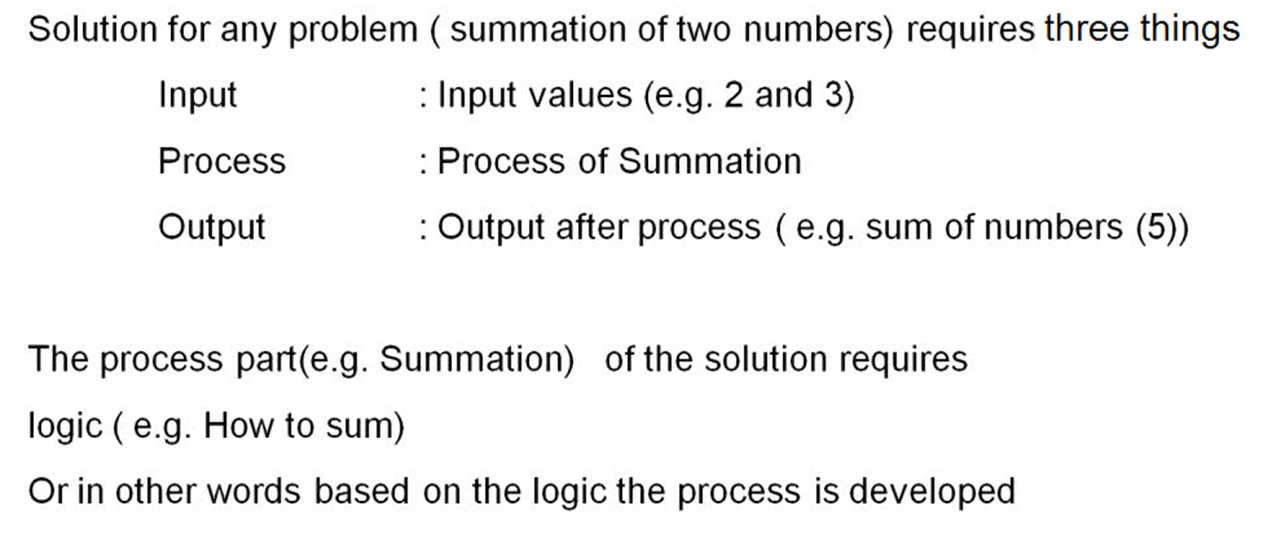
Importance of logic in problem solving

Slide 10
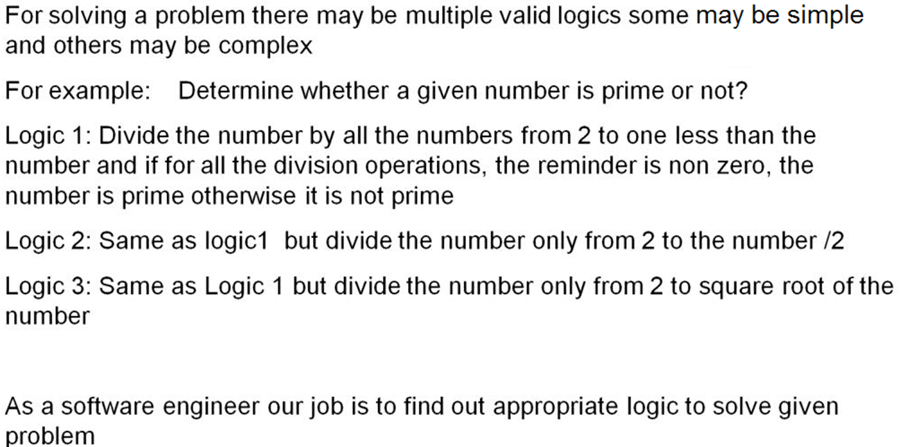
Importance of logic in problem solving

Slide 11
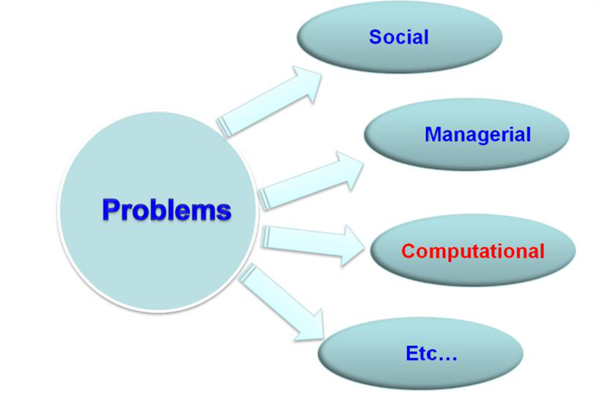
Types of problems

Slide 12
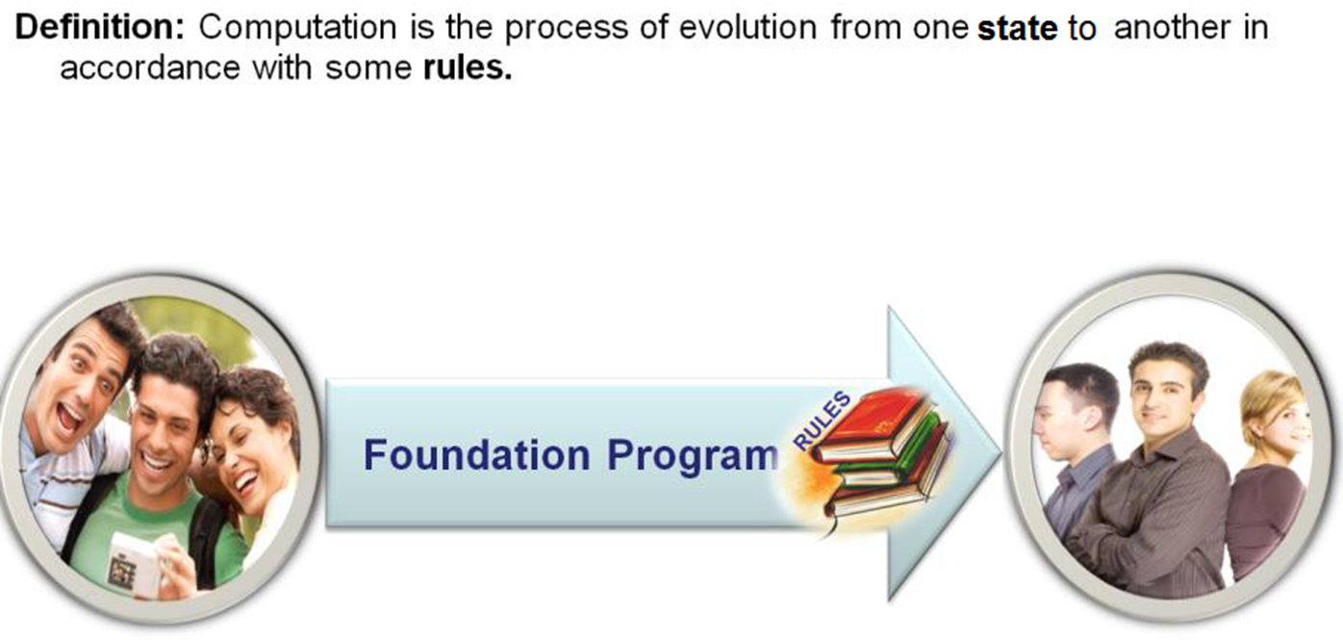
Computational Problems

Slide 13
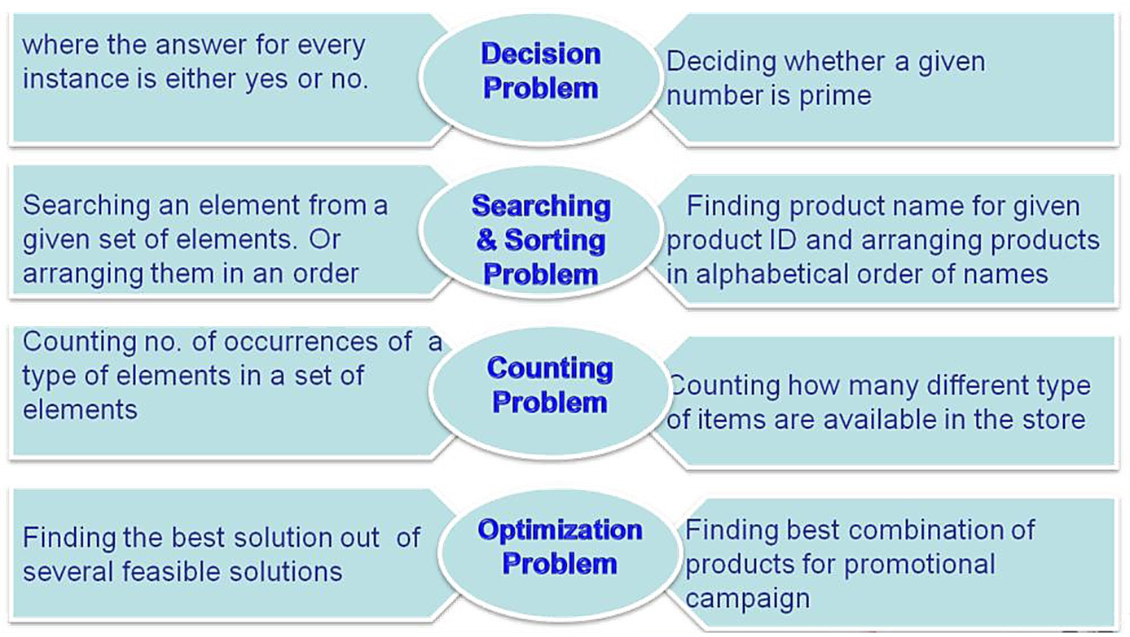
Broad applications of Computational Problem

Slide 14
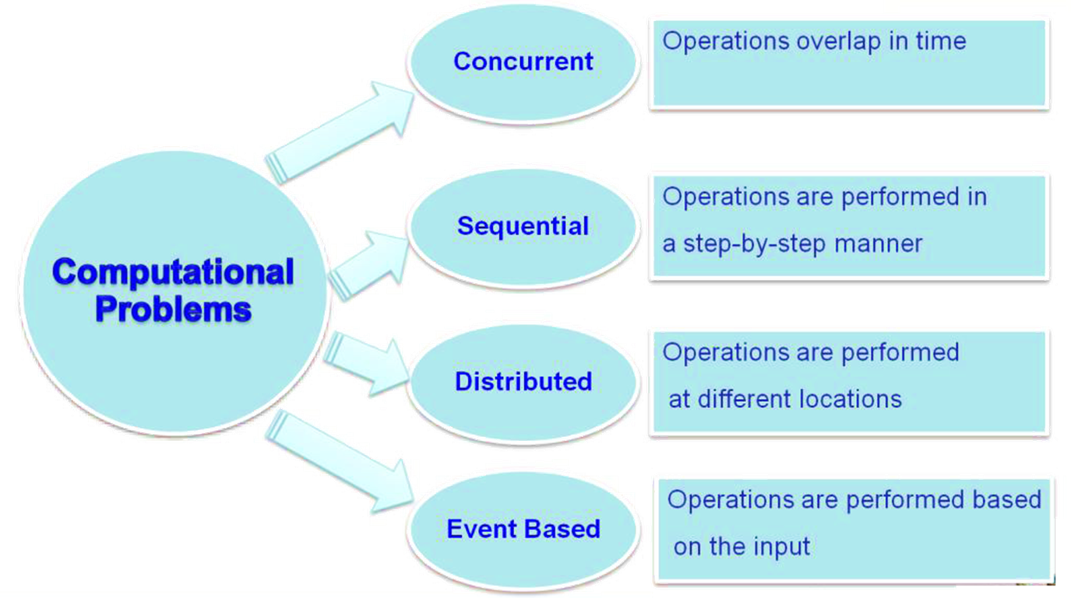
Classification of computational problems

Slide 15
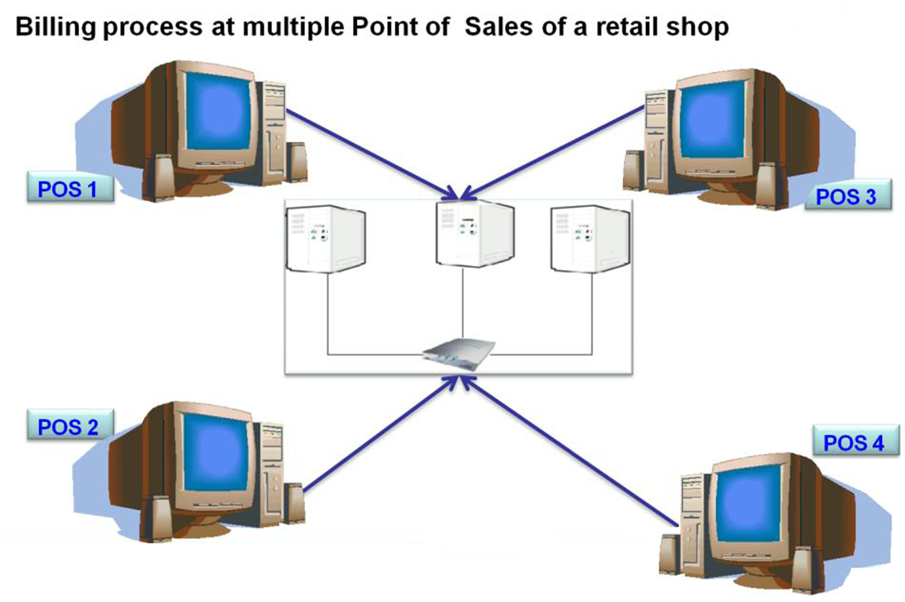
Distributed / Concurrent computation

Slide 16
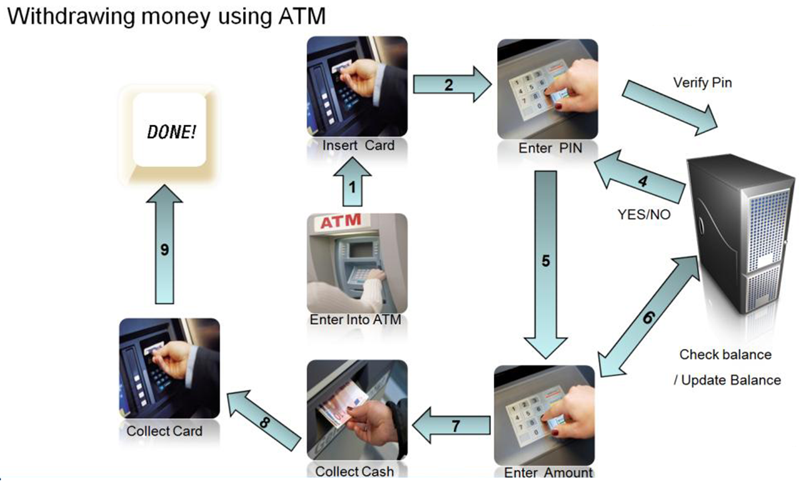
Sequential / Event based computation

Slide 17
Programming Paradigms and Methodologies
The programming methodologies and Paradigms may be put to use during the design and the build phases of the SDLC.
Programming Approaches
Unstructured Programming
Structured Programming [C]
Object Oriented Programming [OOP; C++]
Notes:
Analogy
A programming paradigm is a fundamental style of computer programming. There are four main paradigms: imperative, declarative, functional and object oriented.

Slide 18
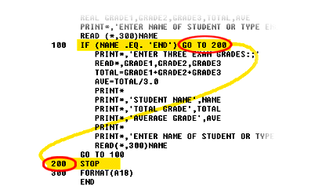
Unstructured Programming-USP
Entire program code is written in a single continuous main program
The main program operates on the data directly
Ex: Basic Language
Notes:
Additional notes on unstructured programming
Non-structured programming is the historically earliest programming paradigm capable of creating Turing-complete algorithms. It has been followed historically by procedural programming and then object oriented programming, both of them considered as structured programming.
Unstructured programming has been heavily criticized for producing hardly-readable code and is sometimes considered a bad approach for creating major projects, but had been praised for the freedom it offers to programmers.
There are both high- and low-level programming languages that use non-structured programming. These include early versions of BASIC, JOSS, FOCAL, MUMPS, TELCOMP, COBOL, machine level code, early assembler systems (without procedural meta-operators), assembler debuggers and some scripting languages such as MS-DOS batch file language.

Slide 19
USP Limitations
As the size of the program increases
Difficult to understand and modify the program.
If something needs to be done more than once it must be re-typed and it is difficult to test a particular part of the code.
All parts of the program can access the data (whether required or not). Hence error in one part of the program can affect the other parts of the program also, there exist more chances of accidental modification to the data.

Slide 20
Structured Programming -SP
Structured or Procedural programming attempts to divide the problem into smaller subtasks or modules which interact with other to complete the given task thereby making the complexity of code manageable.
Modular programming is a software design technique that divides the tasks into sub tasks such that each sub task can be developed independently.
The aim of structured programming is to clearly define the structure of the program before writing program code. Ex: ALGOL, Pascal, Ada etc.
Notes:
Additional notes on structured programming
Structured programming is a programming paradigm aimed on improving the clarity, quality, and development time of a computer program by making extensive use of subroutines, block structures and for and while loops —in contrast to using simple tests and jumps such as the go to statement which could lead to spaghetti code which is both difficult to follow and to maintain.
Some of the languages initially used for structured programming languages include: ALGOL, PASCAL, PL/I and ADA – but most new procedural programming languages since that time have included features to encourage structured programming, and sometimes deliberately left out features in an effort to make unstructured programming more difficult.

Slide 21
Limitations of SP
Structured programming focuses mainly on the algorithm and not on the data on which these algorithms operate.
Structured programming is a good model for small-medium sized projects.
Notes:
Additional information on Similarities between Structured programming and object oriented programming?
In structured programming...the idea was that the overall flow of control of the program was laid out using a function call hierarchy - sort of like an inverted tree. The main routine was at the top and then called routines branched out in successive layers under that. When these functional "trees" were implemented as skeleton code without any real business logic or other body, this was called "Top Down" programming, because the tree was implemented from the "top down" to give it structure, before any of the detail was filled in. In this way the overall flow and structure of a program can be tested before being overwhelmed by detail. Object Oriented programming doesn't think of a single flow of control through the program. Instead, real-world business entities in the problem space are implemented as individual objects with (a) their own data and (b) their own behavior. The program is then put together by implementing logical flow of control from object to object, with each one doing "its own thing" and then calling on other objects to "do their own thing". In this way, it's hoped that overall functionality within the program is encapsulated and divided up logically so that each bit can be implemented separately and, hopefully, re-used in other programs.

Slide 22
Object Oriented Programming
Object oriented programming model is used when the complexity of the problem is more.
Object Oriented Programming (OOP) is often natural and powerful way of representing a real-life situation or problem.
An Object has two components
1. State information which describes the current characteristics of the objects and
2. Behavior which describes how it interacts with other objects
Ex: C++, JAVA languages
Notes:
Additional information – OOP
OOP is a design philosophy. It stands for Object Oriented Programming. Object-Oriented Programming (OOP) uses a different set of programming languages than old procedural programming languages (C, Pascal, etc.). Everything in OOP is grouped as self-sustainable "objects". Hence, you gain re-usability by means of four main object-oriented programming concepts. In order to clearly understand the object orientation, let’s take your “hand” as an example. The “hand” is a class. Your body has two objects of type hand, named left hand and right hand. Their main functions are controlled/ managed by a set of electrical signals sent through your shoulders (through an interface). So the shoulder is an interface which your body uses to interact with your hands. The hand is a well architected class. The hand is being re-used to create the left hand and the right hand by slightly changing the properties of it.
Object
An object can be considered a "thing" that can perform a set of related activities. The set of activities that the object performs defines the object's behavior. For example, the hand can grip something or a Student (object) can give the name or address. In pure OOP terms an object is an instance of a class.
Class
A class is simply a representation of a type of object. It is the blueprint/ plan/ template that describe the details of an object. A class is the blueprint from which the individual objects are created. Class is composed of three things: a name, attributes, and operations.

Slide 23
Summary
Problem solving
Logic and its importance in problem solving
Computational problems and its classifications
programming paradigms and its methodologies
Programming Approaches
Unstructured Programming
Structured Programming [C]
Object Oriented Programming [OOP; C++]
Syntax
Additional Information
Do’s
Don’ts
Control Flow
Video clip
Case studies
Do it yourself

